Slide 1


Technology, Aging, and Jobs in Asia
KIPF/HAPI Conference
Fiscal and Tax Reform: Policy Responses
for Low Fertility and Aging Society
Honolulu, Hawaii, 18-19 April 2024
Yasuyuki Sawada
ADB Institute and University of Tokyo

Slide 2
Three Topics
Technologies play a critical role in augmenting the third demographic dividends:
Silver dividends in Asia
Technologies and aging
Moving forward

Slide 3
Three Topics
Technologies play a critical role in augmenting the third demographic dividends:
Silver dividends in Asia
Technologies and aging
Moving forward

Slide 4
Measuring Health Capacity to Work
What is the scale of “tapped” and “untapped or additional” health capacity to work among older persons in the region?
Aiko Kikkawa, Takashi Oshio, Yasuyuki Sawada, Satoshi Shimizutani, Naohiro Ogawa, Albert Park, and Tetsushi Sonobe. 2024. “Health Capacity to Work among Older Persons in Asia: Key Findings from a Regional Comparative Study.” Asian Development Review, forthcoming.
Two common methodologies applied to seven countries in Asia:
Milligan and Wise (MW) (2015) method: It examines how much people with a given mortality rate could work if they were to work as much as those with the same mortality rate in the past.
Cutler, Meara, and Richards-Shubik (CMR) (2013) method: It examines how much people with a given level of health could work if they were to work as much as their younger counterparts in similar health conditions.

Slide 5
ADB’s Regional Comparative Study
COUNTRY | DATA | AUTHORS
People’s Republic of China | CHARLS 2018 | Zeyuan Chen and Albert Park
Vietnam | VNAS 2 2019 | Long Thanh Giang, Aiko Kikkawa, and Donghyun Park
Republic of Korea | KloSA 2006-2020 | Sang-Hyop Lee, Cheol-Kon Park, Hyun Kyung Kim, and Donghyun Park
Malaysia | MARS 2019 | Norma Mansor, Halimah Awang, and Donghyun Park
Japan | Comprehensive Survey of Living Conditions of 2019 | Takashi Oshio, Satoshi Shimizutani, and Aiko Kikkawa
Indonesia | IFLS 2014 | Ni Wayan Suriastini, Ika Yulia Wijayanti, and Dwi Oktarina
Thailand | HART 2019 | Jiaying Zhao, Chi Kin Law, John Piggott, and Vasoontara Sbirakos Yiengprugsawan

Slide 6
Measuring Health Capacity to Work by MW
Country | 2010 versus 1977 | 2010 versus 1995
Belgium | 5.0 | 1.0
Canada | 4.9 | 1.3
Denmark | 4.7 | 1.6
France | 8.0 | 2.2
Germany | 5.9 | 2.6
Italy | 7.7 | 2.7
Japan | 3.7 | 2.2
The Netherlands | 3.4 | -0.1
Spain | 7.0 | 2.2
Sweden | 3.2 | 0.8
United Kingdom | 8.4 | 1.8
United States | 4.2 | 1.8
Additional Years of Health Capacity to Work among Older Persons Aged 55–64 Years by Gender
Country | Male | Female
Indonesia | -0.17 | 0.17
Japan | 0.24 | -0.59
Malaysia | 1.06 | 0.05
PRC | 2.24 | 2.86
Republic of Korea | 0.75 | 0.09
Thailand | 0.79 | 1.11
Viet Nam | 0.24 | 0.18
Average | 0.74 | 0.55
Note: Standardized using a 15-year gap for the period of 2000–2020.
Source: Aiko Kikkawa, Takashi Oshio, Yasuyuki Sawada, Satoshi Shimizutani, Naohiro Ogawa, Albert Park, and Tetsushi Sonobe. 2024. “Health Capacity to Work among Older Persons in Asia: Key Findings from a Regional Comparative Study.” Asian Development Review, forthcoming.
Average
5.5
1.7
Source: Coile, C., K. Milligan, and D. Wise. 2017. Health Capacity to Work at Older Ages: Evidence from the United States. In Social Security Programs and Retirement.

Slide 7
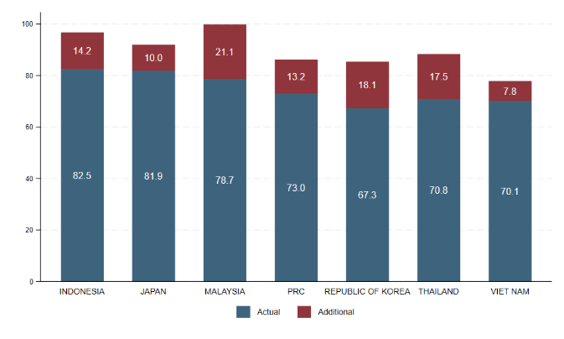
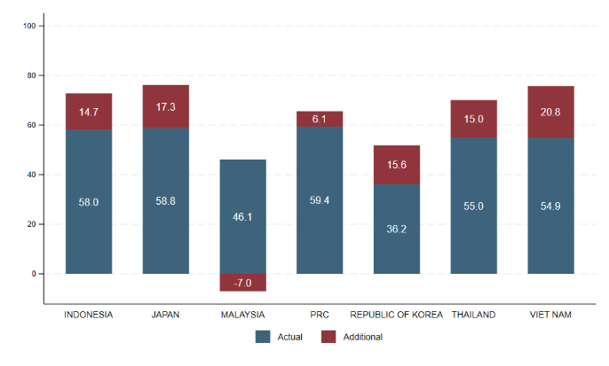
Measuring Health Capacity to Work by CMR
Additional Work Capacity by Age Group and Gender
Male, 60–64 years old
Female, 60–64 years old
PRC = People’s Republic of China.
Source: Aiko Kikkawa, Takashi Oshio, Yasuyuki Sawada, Satoshi Shimizutani, Naohiro Ogawa, Albert Park, and Tetsushi Sonobe. 2024. “Health Capacity to Work among Older Persons in Asia: Key Findings from a Regional Comparative Study.” Asian Development Review, forthcoming.

Slide 8
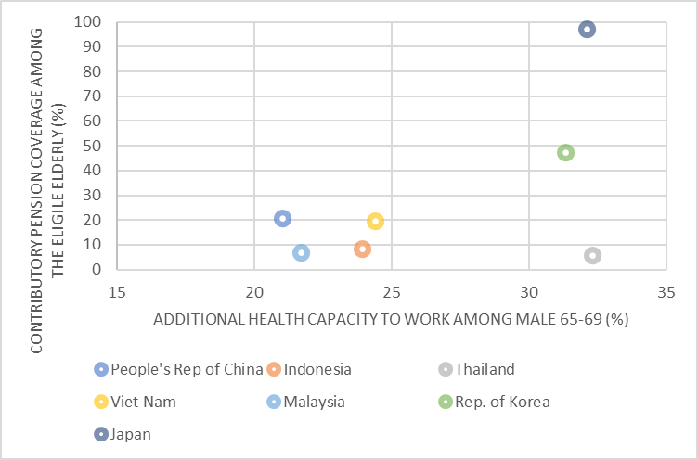
Untapped Work Capacity and Pension Coverage
Additional Health Capacity to Work in Men (Aged 65–69 Years) and the Contributory Pension Coverage(%)
Sources: OECD (2018) and Aiko Kikkawa, Takashi Oshio, Yasuyuki Sawada, Satoshi Shimizutani, Naohiro Ogawa, Albert Park, and Tetsushi Sonobe. 2024. “Health Capacity to Work among Older Persons in Asia: Key Findings from a Regional Comparative Study.” Asian Development Review, forthcoming.

Slide 9
Silver or the Third Demographic Dividend
The daily minimum wage in each country at the time of the survey is used
Any scope for augmenting the dividend by technologies?
Country | Total Value of Untapped Work (ages 60–79) |  | % Increase in GDP if All Untapped Work Is Utilized
 | Value ($ million) | Year
Indonesia | 5,979 | 2014 | 0.7
Japan | 226,683 | 2019 | 4.4
Republic of Korea | 51,510 | 2020 | 3.1
Malaysia | 1,586 | 2020 | 0.5
PRC | 121,337 | 2018 | 0.9
Thailand | 7,642 | 2015 | 1.9
Viet Nam | 5,721 | 2019 | 2.2
Table 4: Silver Dividend in Asia
GDP = gross domestic product, PRC = People’s Republic of China.
Source: Authors’ estimation based on findings from Chen and Park (forthcoming) for the PRC; Giang, Kikkawa, and Park (forthcoming) for Viet Nam; Lee et al. (forthcoming) for the Republic of Korea; Mansor, Awang, and Park (forthcoming) for Malaysia; Oshio, Shimizutani, and Kikkawa (forthcoming) for Japan; Suriastini, Wijayanti, and Oktarina (forthcoming) for Indonesia; and Zhao et al. (forthcoming) for Thailand.

Slide 10
Three Topics
Technologies play a critical role in augmenting the third demographic dividends:
Silver dividends in Asia
Technologies and aging
Moving forward

Slide 11
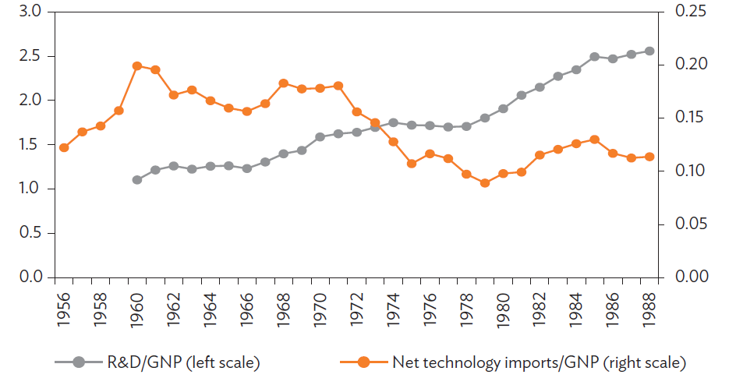
(5) Accelerating technological progress
Accelerating Technological Progress in Asia
Contribution to Asia’s GDP Growth (% of total)
Innovation
Human capital
Research institutes
Private R&D
Competition
Top 5 Patent Grantees in the United States
Adoption
Students/people abroad
Licensing design/patent
Reverse engineering
Machinery imports
FDI, TC aid
Trade
Adoption and Innovation of Technologies in Japan,
1956–1988 (%)
Number of patents granted in the US
Source: ADB (2020). Asia's Journey to Prosperity: Policy, Market, and Technology Over 50 Years. Asian Development Bank.

Slide 12
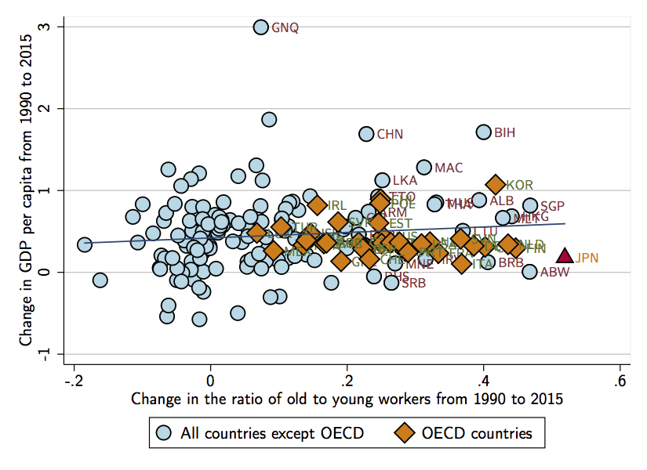
Technologies and Aging
Does population aging lead to lower productivity and economic growth?
Acemoglu and Restrepo (2017): The correlation is insignificant (left)
Why?
“Induced technological changes”: Companies have offset any negative impacts from a wave of retiring workers by replacing them with technology, such as robots and artificial intelligence.
Note) An aging population is defined as the ratio of people over the age of 50 to those between 20 and 49). The data sources are the Penn World Tables and the United Nations for 169 countries over a 25-year span.
Source) Acemoglu, Daron, and Pascual Restrepo. 2017. "Secular Stagnation? The Effect of Aging on Economic Growth in the Age of Automation." American Economic Review, 107 (5): 174-79.

Slide 13
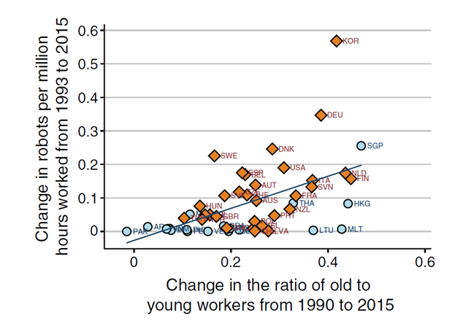
Induced Technological Change?
For Asia, the global leader in robotics, has the scarcity of younger and middle-aged labor prompted increased robot adoption?
Japan is the single largest manufacturer of robots. Japan, the PRC, and the ROK accounted for about 75% of all robots made globally in 2015.
Source) Acemoglu, Daron, and Pascual Restrepo. 2017. "Secular Stagnation? The Effect of Aging on Economic Growth in the Age of Automation." American Economic Review, 107 (5): 174-79.
Source: United Nations Conference on Trade and Development (UNCTAD). 2017. Box 3.1 in Trade and Development Report 2017. Beyond Austerity: Towards a Global New Deal. Geneva

Slide 14
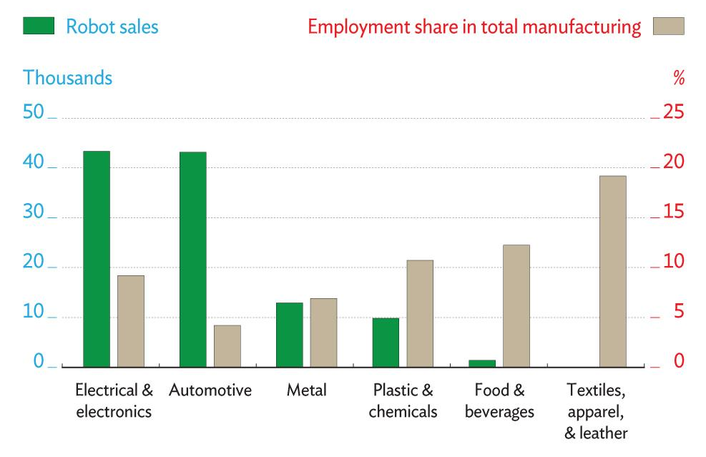
Induced Technological Change?
Source: Asian Development Outlook 2018: How Technology Affects Jobs.

Slide 15
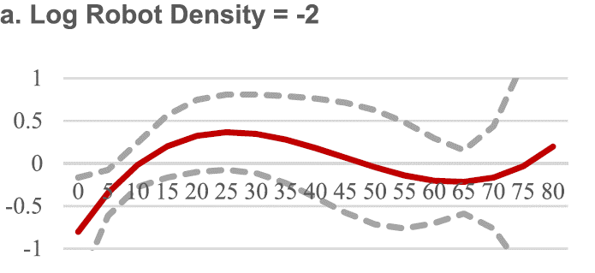
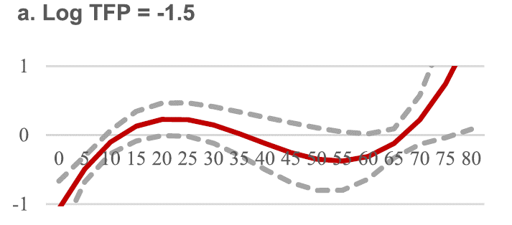
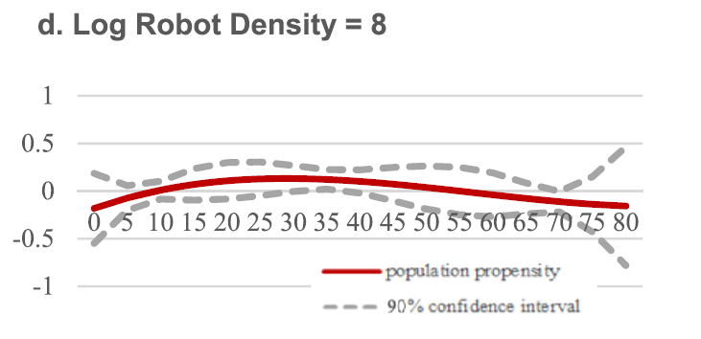
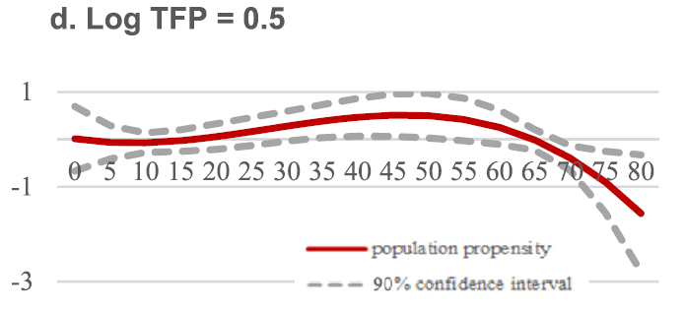
Induced Technological Change?
Increasing life expectancy, total factor productivity and labor productivity help older age groups contribute more positively to per capital GDP growth (Park, Shin, and Kikkawa, 2022).
Age-Group Coefficients for 5-Year GDP Per Capita Growth
Cyn-Young Park, Kwanho Shin, Aiko Kikkawa, 2022. Demographic change, technological advance, and growth: A cross-country analysis, Economic Modelling 108, 105742.

Slide 16
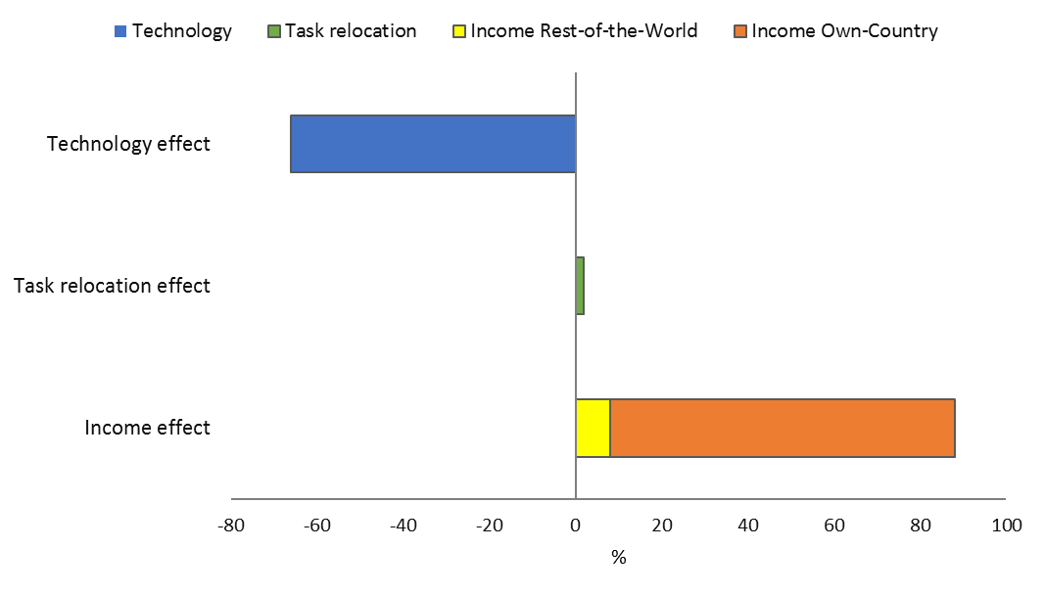
Robots, TFP, and 4thIR: Asia’s Job Prospects?
Technical feasibility does not guarantee economic feasibility.
Rising income and demand through GVCs.
New technologies often automate only some tasks of a job.
New occupations and industries.
Decomposing the percentage change in employment, 2005-2015, ADB (2018)
Note: Developing Asia in the decomposition analysis includes Bangladesh, India, Indonesia, Malaysia, Mongolia, the People’s Republic of China, the Philippines, the Republic of Korea, Sri Lanka, Taipei,China, Thailand, and Viet Nam.
Source: Asian Development Outlook 2018: How Technology Affects Jobs.

Slide 17
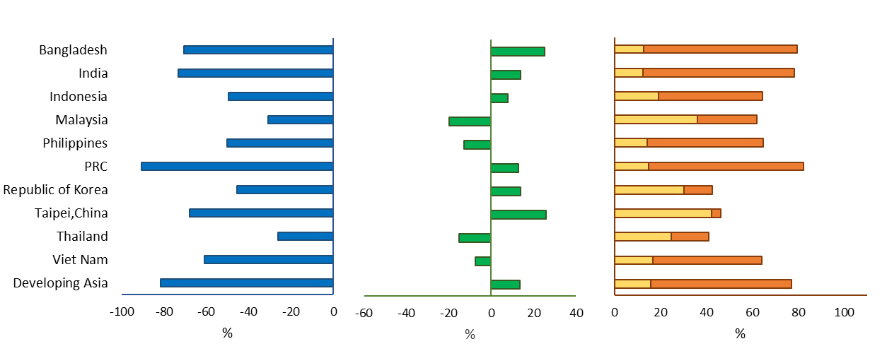
This Countervailing Force is at Work across the Region
Technical feasibility does not guarantee economic feasibility.
Rising income and demand through GVCs.
New technologies often automate only some tasks of a job.
New occupations and industries.
Manufacturing
GVC = global value chain, PRC = People’s Republic of China.
Note: Developing Asia in the decomposition analysis includes Bangladesh, India, Indonesia, Malaysia, Mongolia, the People’s Republic of China, the Philippines, the Republic of Korea, Sri Lanka, Taipei,China, Thailand, and Viet Nam.
Source: ADB estimates using the ADB Multiregional Input–Output Database (accessed 20 November 2017); Labor force surveys, various countries; World Input–Output Database—Socioeconomic Accounts (Timmer et al. 2015).

Slide 18
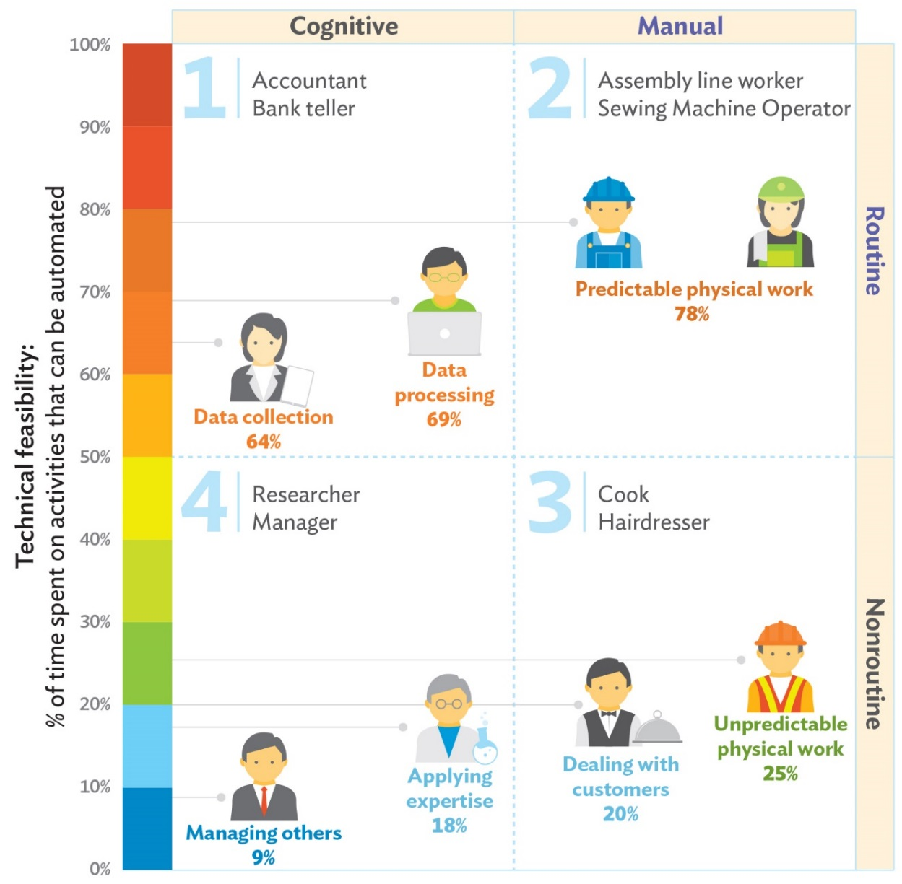
New Technologies and Job Displacement
Technical feasibility does not guarantee economic feasibility.
Rising income and demand through GVCs.
New technologies often automate only some tasks of a job.
New occupations and industries.
Note: Percentages refer to Frey and Osborne (2017) estimates on probability of automation. Framework is based on Acemoglu and Autor (2011).
Source: Asian Development Outlook 2018: How Technology Affects Jobs.

Slide 19
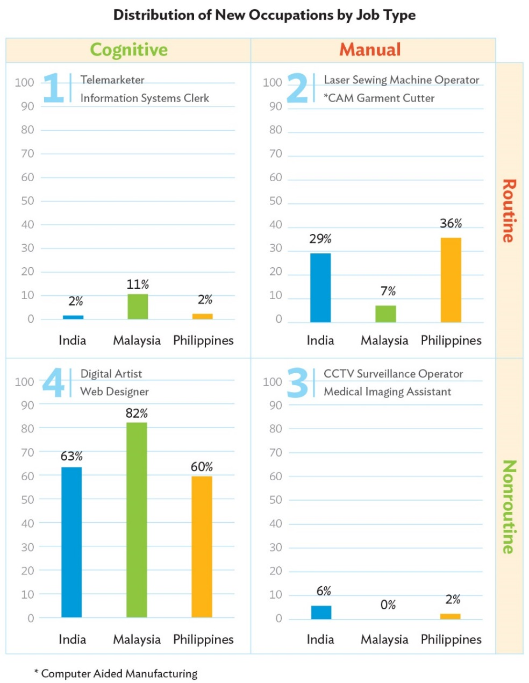
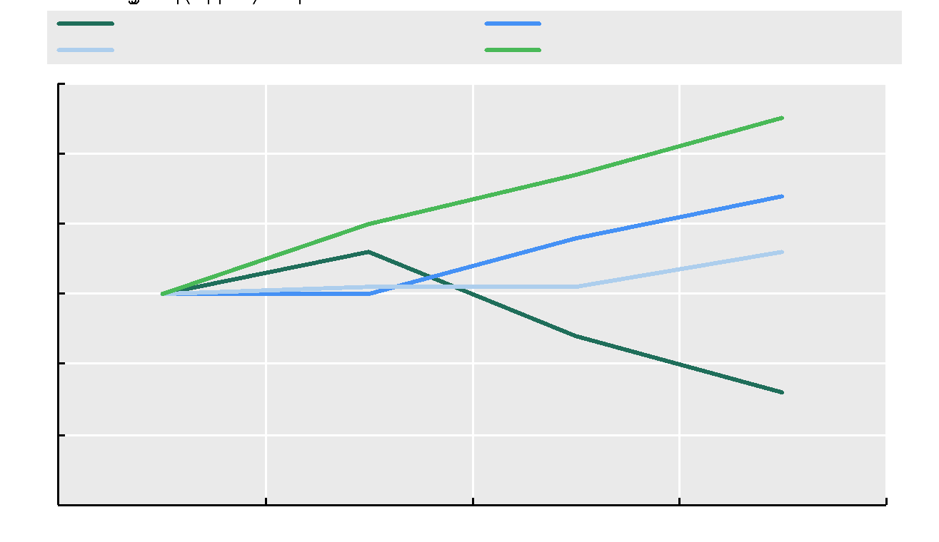
New Technologies and Jobs for Older Individuals?
Occupational Characteristics of Workers across Age Groups
in Europe, Normalized at Age 25-34, 2018-2020
Note: Data show the unweighted average of 26 European countries: Austria, Belgium, Czechia, Denmark, Estonia, Finland, France, Germany, Greece, Hungary, Iceland, Ireland, Italy, Latvia, Lithuania, Luxembourg, the Netherlands, Norway, Poland, Portugal, Slovenia, Slovak Republic, Spain, Sweden, Switzerland and the United Kingdom.
Data source: EU Statistics on Income and Living Conditions (EU-SILC), O*NET work abilities, skills, environment data.
Source: OECD (2024), Promoting Better Career Choices for Longer Working Lives: Stepping Up Not Stepping Out, Ageing and
Employment Policies, OECD Publishing, Paris, https://doi.org/10.1787/1ef9a0d0-en.
Notes: The figures are based on a comparison of National Classification of Occupations (NCO) for each country. Job titles presented in the 4 quadrants are actual new titles.
Source: Asian Development Outlook 2018: How Technology Affects Jobs

Slide 20
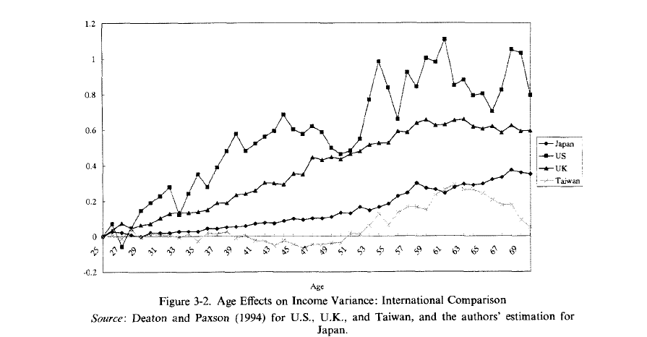
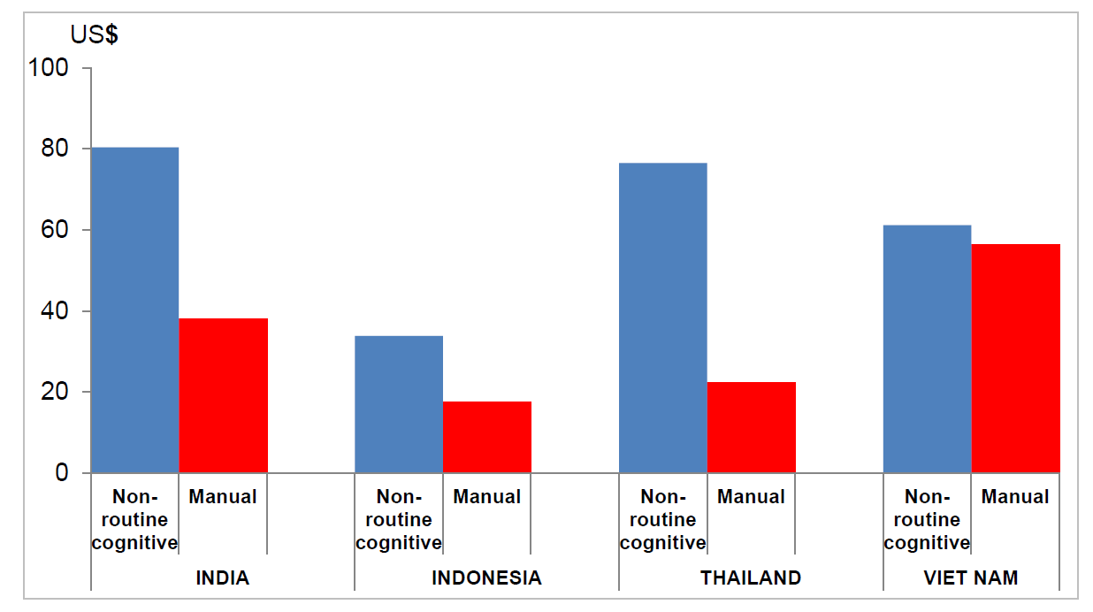
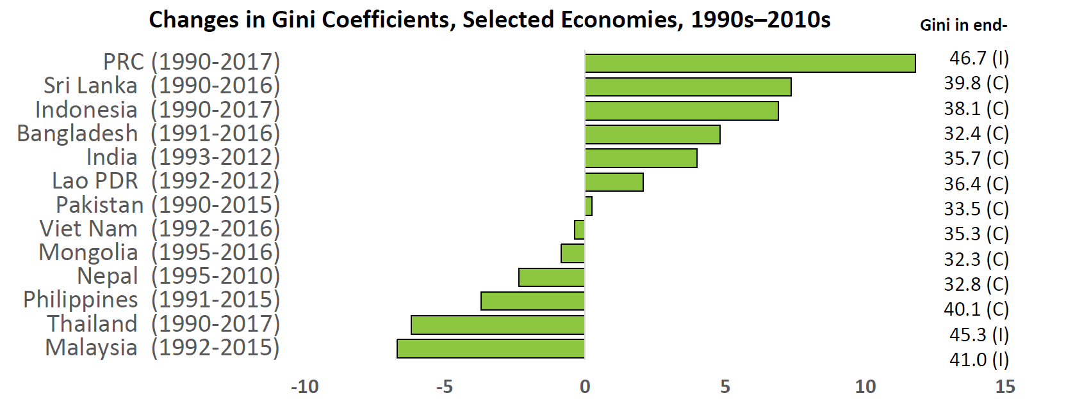
Rising Technological Inequalities?
Change in Average Monthly Wages, Constant Prices (in US$)
Source: Deaton, Angus and Paxson, Christina, (1994). Intertemporal Choice and Inequality, Journal of Political Economy 102(3), 437-67 for US, UK, and Taiwan; and Ohtake, Fumio and Makoto Saito (1998). Population Aging and Consumption Inequality in Japan, Review of Income and Wealth 44(3).
Note: The time frames vary across countries, with Viet Nam the shortest (2007‒2015), followed by Thailand (2000‒2010), India (2000‒2012), and Indonesia (2000‒2014). Developing Asia refers to the five countries included in this analysis. Source: Asian Development Outlook 2018: How Technology Affects Jobs
Source: ADB (2020). Asia's Journey to Prosperity: Policy, Market, and Technology Over 50 Years. Asian Development Bank.

Slide 21
Three Topics
Technologies play a critical role in augmenting the third demographic dividends:
Silver dividends in Asia
Technologies and aging
Moving forward

Slide 22
Discussion: Technological Solutions
Type of Technology | Examples
Technology for transforming work and workplace | Industrial robots, automation, AI, machine learning, and WFH platforms
Technology for workers and supportive labor market infrastructure | Remote and virtual education and training; human resource and age diversity management; cloud-based job matching service; ergonomic and human function aiding devices at the workplace (adaptive technologies).
Technology for health and longevity | Biotechnology, automated diagnosis, surgery and therapies. The IOT (medical equipment and wearable devices), and health-related big data analysis.
Technology for social inclusion | Digitally-managed pension with work incentives; digitalized social protection programs such as biometric information; and e-tax systems

Slide 23
Discussion: Indispensable Private Finance?
Asia Pacific region’s annual investment requirements, 2016-2030, to meet SDGs (by broad SDG sectoral groupings)
In addition to augmenting the silver dividend, developing Asia needs to build back better.
Green and social finance are specifically targeted toward SDGs.
With limited public resources, private capital must be mobilized.
$ 1.5 trillion annual investment
(4% regional GDP)
ICT = information, communications and technology, SDG = sustainable development goals, WSS = water, sanitation, and safe water. Source: UNESCAP (2019).

Slide 24
Main Messages
Asian countries possess both tapped and untapped or additional health capacity to leverage.
Augmenting the silver dividend is crucial for sustaining growth and development.
The advent of labor-saving technologies may have been induced by the aging workforce, leading to higher income and demand through Global Value Chains (GVCs).
Older populations have the potential to benefit from new occupations and emerging industries.
Technology solutions play a critical role in transforming work and workplaces, supporting labor market infrastructure, promoting health and longevity, and fostering social inclusion.
With limited public resources, mobilizing private capital is essential to enhance the silver dividend and facilitate a stronger recovery.

Slide 25
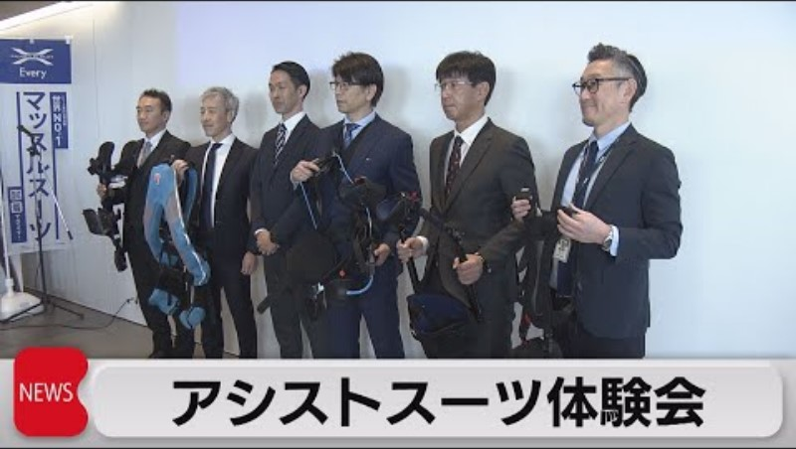
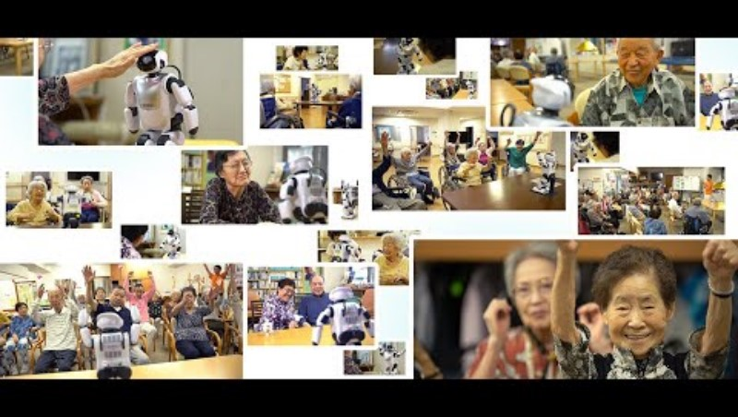


“Assist-Suits” for Labor Participation of Older Individuals
Multi-Purpose Elders Care Robot “Palro”
Line-Based Watching-Over Service “Enrich”
Comprehensive Watching-Over Service “SECOM”

